Slide 1
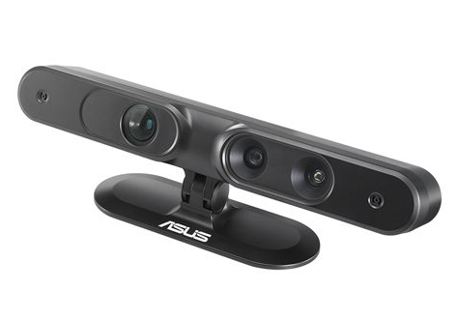
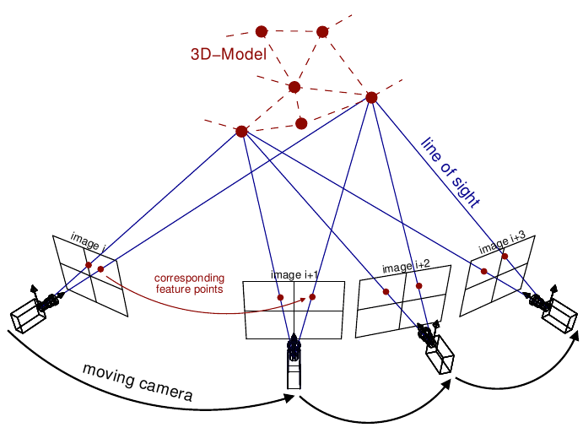

Picture courtesy: Van Riel, Sjoerd, “Exploring the use of 3D GIS as an analytical tool in archaeological excavation practice,” June 2016.
Structure from Motion and RGBD Depth Fusion
RGBD Sensor
Thesis Defense: Advised by : Committee:
Akash Chandrashekar Dr. Andrew Willis Dr. Srinivas Akella
Dr. Min Shin Dr. Hamed Tabkhi
SfM

Slide 2
Outline
What are depth maps and its applications
Economical source of depth measurement : RGBD sensor
Limitations of RGBD sensors
Efficient way to estimate depth : SfM
Limitations of SfM
Fusion of RGBD depth with SfM
Contribution and methodology
Results and further work

Slide 3
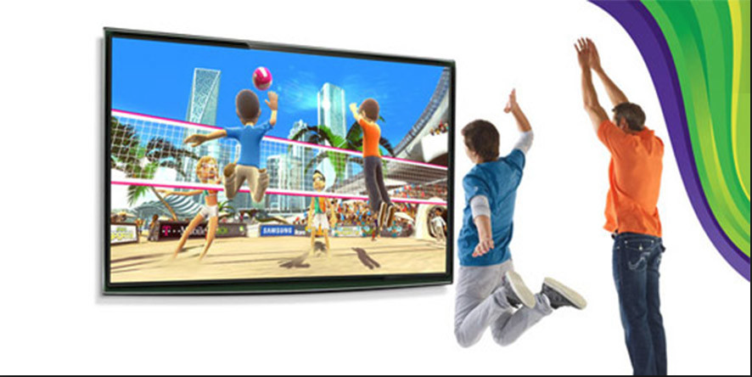
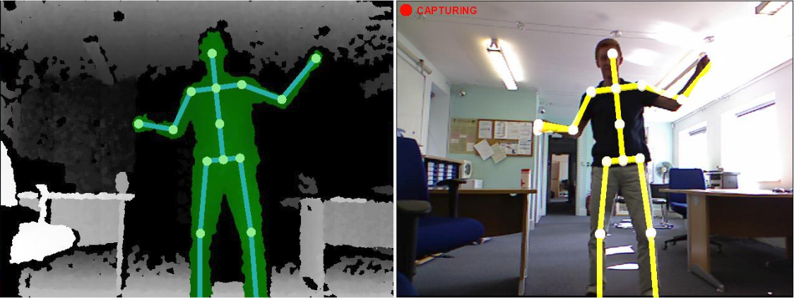
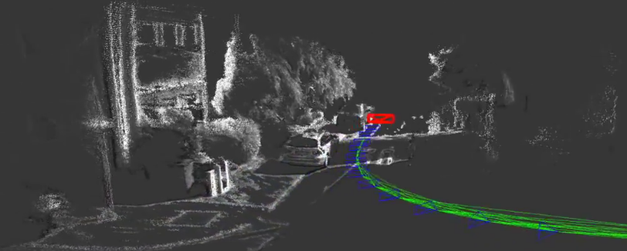
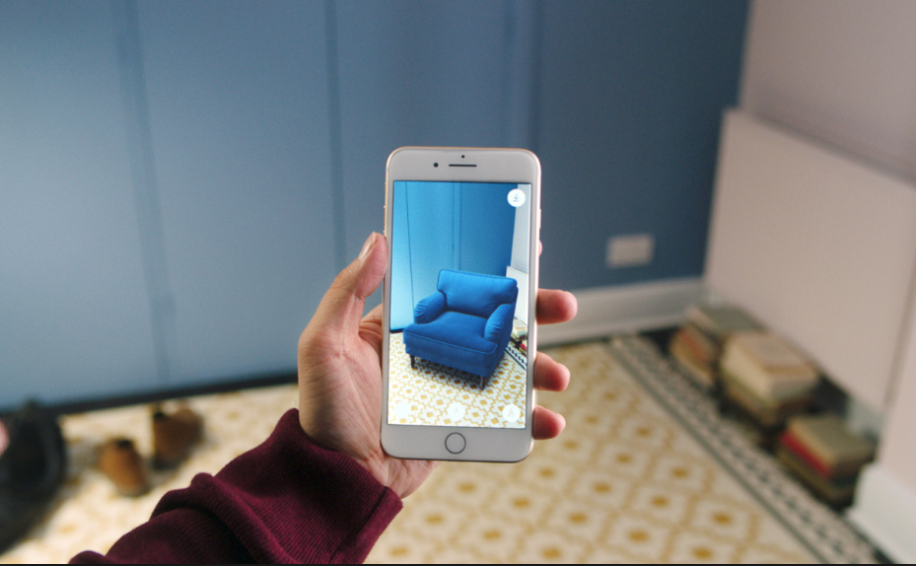
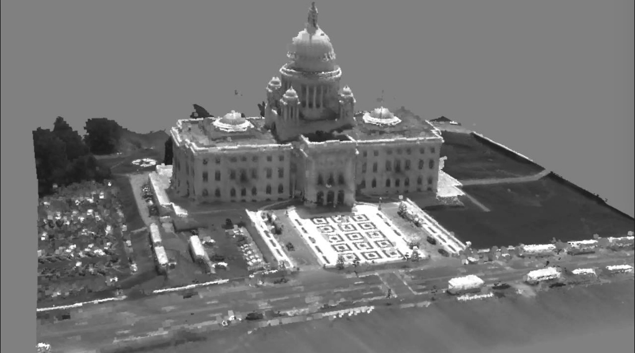
Depth maps and its Applications
Depth map is an image that contains information relating to the distance of the surfaces of scene objects from a viewpoint.
Mapping and localization
Autonomous navigation/guidance
Augmented Reality
Interactive Gaming
Object Recognition
Motion capture
3D reconstruction
Picture courtesy: Google images

Slide 4
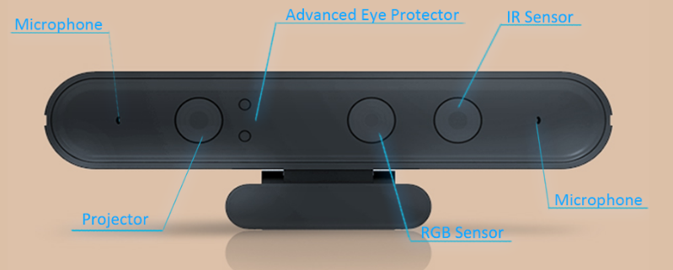
RGBD Sensors
Economical in comparison with LIDAR and SONAR. Makes them suitable for consumer products.
Simultaneously capture color “RGB” images and the depth “D” images of the scene.
Relies on structured light or TOF technology to measure the depth of the scene.
Along with the traditional camera (RGB sensor) it has an infrared (IR) projector and an infrared (IR) sensor.
We have used Orbbec Astra Pro RGBD sensor.
Has a field of view of 60° horiz x 49.5° vert.
Captures RGB images of dimension 640 * 480 @ 30FPS.
Captures depth images of dimension 640 * 480 @ 30FPS.
Has range of 0.6 - 8 m.
Generates ~64 megabytes of data stream.
Picture courtesy: Google images

Slide 5
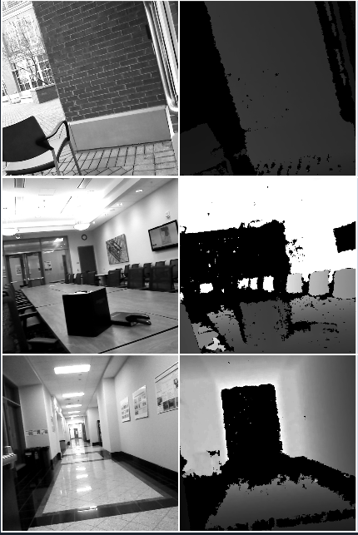
Limitations of RGBD Sensors
RGBD sensors often fail to provide meaningful depth values in sunlit outdoor scenes.
RGBD sensors also fail in sunlit indoor scenes.
RGBD sensors have range limitation (~8m).
RGBD sensors fail to collect measurements from surfaces having specific reflectance properties like
Dark surfaces
Specular, mirror-like

Slide 6
Structure From Motion (SfM)
The Structure from Motion (SfM) is a photogrammetric approach to estimate the three dimensional structure of a scene from a time series of RGB images.
The SfM consequently solves for two groups of unknowns.
Relative pose of the camera between the frames, each poses are represented in sim(3) with 7 degrees of freedom.
Depth of 3D structure at all valid pixels , potentially there are w * h depths for each frame, where w and h are width and height of the frame .
Picture courtesy: Van Riel, Sjoerd, “Exploring the use of 3D GIS as an analytical tool in archaeological excavation practice,” June 2016.

Slide 7
Limitations of SFM
Scale of the estimated depth is unknown.
Fails to estimate depths for homogeneous surfaces.
If the errors are not handled, there will be a drift in the camera motion estimation and consequent depth estimation.
Computationally expensive.

Slide 8
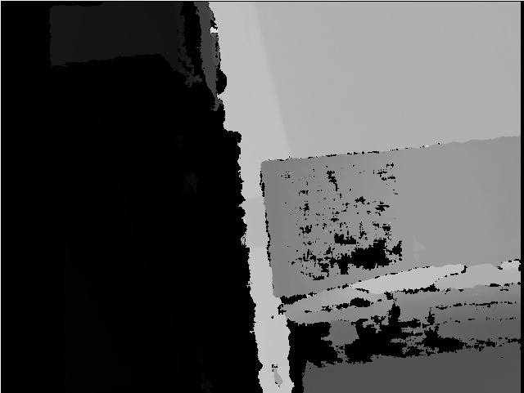
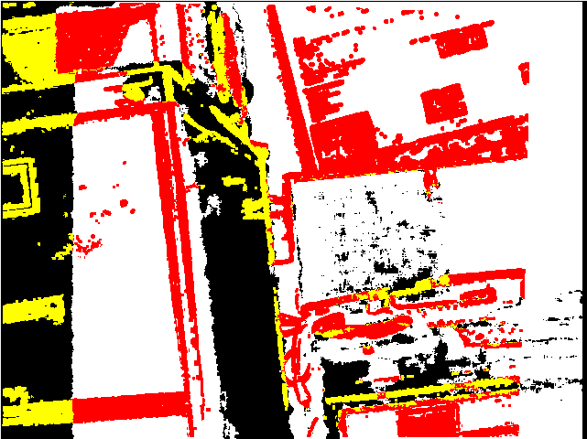
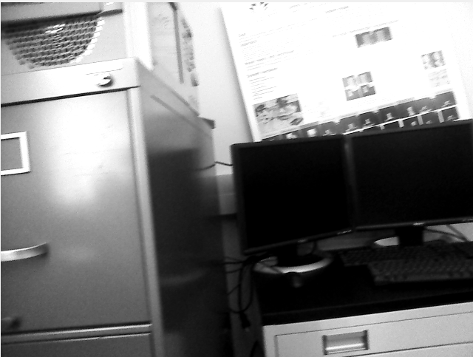
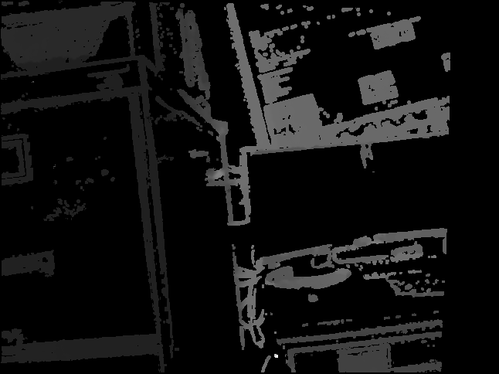
Fusion of RGBD depth with SfM
Bootstrap SfM with RGBD depths for scale injection.
Fuse RGBD measurements with SfM measurements.
RGBD measurements
Novel
SFM estimates
Fused depths

Slide 9
Large Scale Direct Monocular (LSD) SLAM
We are using LSD SLAM as our SfM implementation.
J. Engel, T. Schöps, and D. Cremers, “LSD-SLAM: Large-scale direct monocular SLAM,” pp. 834–849, 2014.
The LSD-SLAM iteratively performs the following steps on every new frame:
Pose estimation : Local pose change between frames
Depth estimation : Depths for camera Keyframes
Global optimization : Camera trajectory optimization and loop closure
LSD-SLAM implementation was ported to ROS-Kinetic from ROS-Indigo

Slide 10
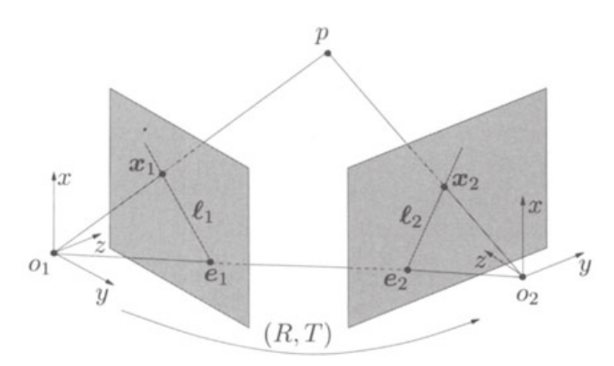
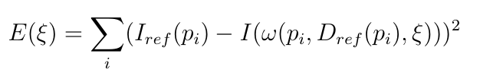
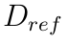
LSD SLAM 1: Pose Estimation
Pose is estimated by solving for image alignment.
The pose change between frames contains a rotation R and translation T, which are together represented by
They are estimated by optimizing the squared 2-norm of residuals called the reprojection error.
Where, I is the current keyframe and is the reference depth associated with it. is a subset of pixel with valid depths. is the projection function.

Slide 11
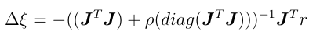
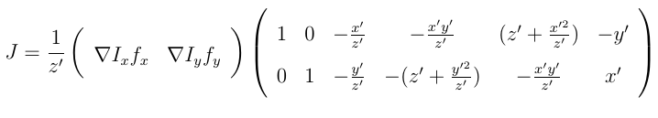
Non-linear optimization
Solving for optimal is a non-linear optimization problem.
Solved in iteration for linear change in by Levenberg_Marquardt algorithm.
r is the residual and J is its Jacobian.

Slide 12
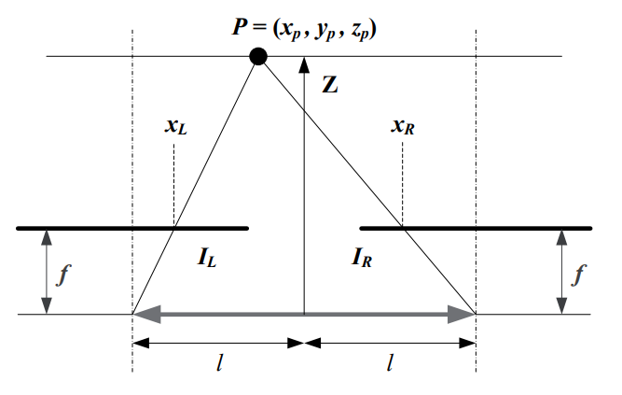
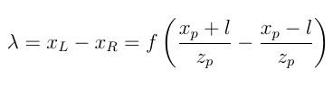
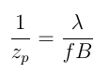
LSD SLAM 2: Depth Estimation
The LSD SLAM estimates depth, , by disparity, , mapping.
The amount of distance that the object has shifted from first image to second is called the disparity.
Picture courtesy: Google images

Slide 13
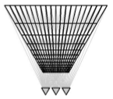
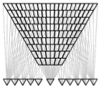
Multi-View Reconstruction
The problem with the fixed baseline disparity computation is that the error grows quadratically with depth.
The depth estimates are accurate if the baseline is proportional to the depth being estimated.
This can be addressed efficiently by using adaptive baseline instead of fixed baseline.
For given pixel, reference image is selected based on the age of the pixel. i.e., the oldest frame with reference to which valid depth was constructed.
Picture courtesy: D. Gallup, J. M. Frahm, P. Mordohai, and M. Pollefeys, “Variable baseline/resolution stereo,” in 2008 IEEE Conference on Computer Vision and Pattern Recognition, pp. 1–8, June 2008.

Slide 14
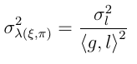
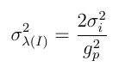
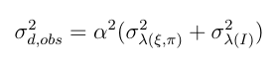
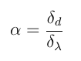
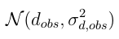
Semi-dense depth and its variance
Disparity is searched along the epipolar line , and influenced by the gradient of the image .
Disparity is subject to geometric disparity error and photometric disparity error.
Geometric disparity error is caused by the error in pose and camera calibration . Measured by the dot product between the normalized epipolar line and the normalized gradient.
Photometric disparity error is defined by magnitude I of the gradient.
Total error is defined as with , δ d is the searched inverse depth interval, and δ λ the length of the searched epipolar line segment.

Slide 15
LSD-SLAM 3 : Graph Optimization
Efficient way to solve the trajectory of the camera over time.
Takes advantage of sparse representation of the graph.
Easy definition of different spaces and supports arbitrary parameterizations within the same problem.
Keyframes are represented as nodes.
Relative pose between images are the constraint / edges between nodes.
Helps solve loop closure and global optimization.

Slide 16
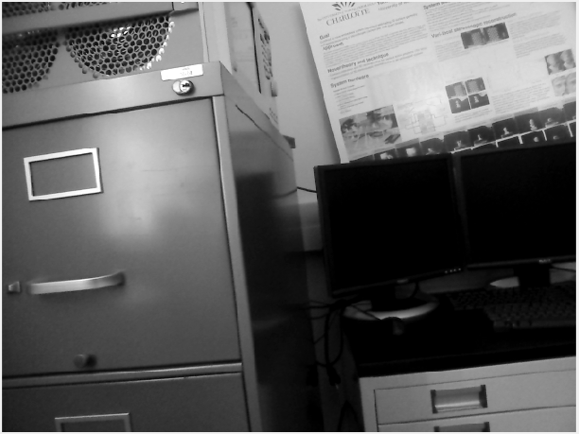
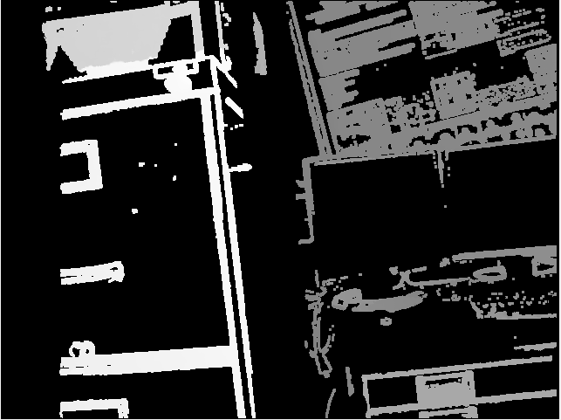
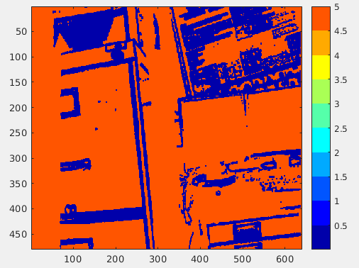
LSD SLAM Overview
Keyframe
LSD SLAM is a semi-dense, direct method.
The output is a reconstruction of the observed 3D environment as a pose-graph.
The pose is estimated between RGB frame and each RGB keyframe.
The depths are computed by estimating disparity along the epipolar lines between new tracking frame and reference frames.
For every keyframe a semi-dense depth map is generated along with its variance.
Keyframe depth
Depth variance

Slide 17
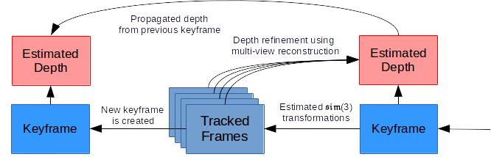
LSD SLAM pipeline

Slide 18
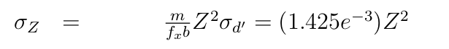
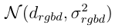
Noise Models
RGBD sensors provide depth measurements wherever it does not fail.
It is empirically observed that a Gaussian noise model provides a good fit to observed measurement errors on planar targets, with mean zeros and sigma as below:
With this variance, the sensor depth measurement at every pixel is represented as :
We have the Gaussian noise model for LSD SLAM observed depths, which is represented as :

Slide 19
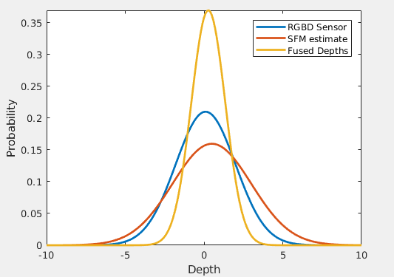
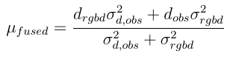
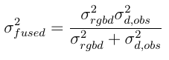
Depth Fusion
Depths are fused by Gaussian multiplication which provides better standard deviation.

Slide 20
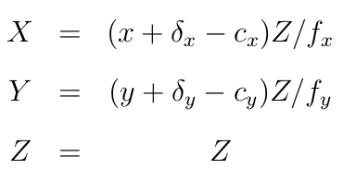
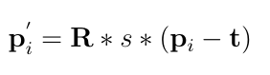
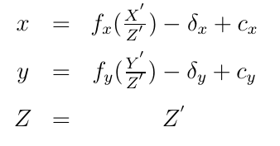
How to Compute Fused Depth at every frame
LSD SLAM generates depths only for keyframes.
However, LSD SLAM estimates the relative pose for all tracked frames.
Depths at each tracked frame can be extrapolated as following:
Depth from keyframes are back-projected into a point cloud.
The point cloud is transformed by the estimated relative pose.
Transformed point cloud is projected to the depth map at current tracked frame.

Slide 21
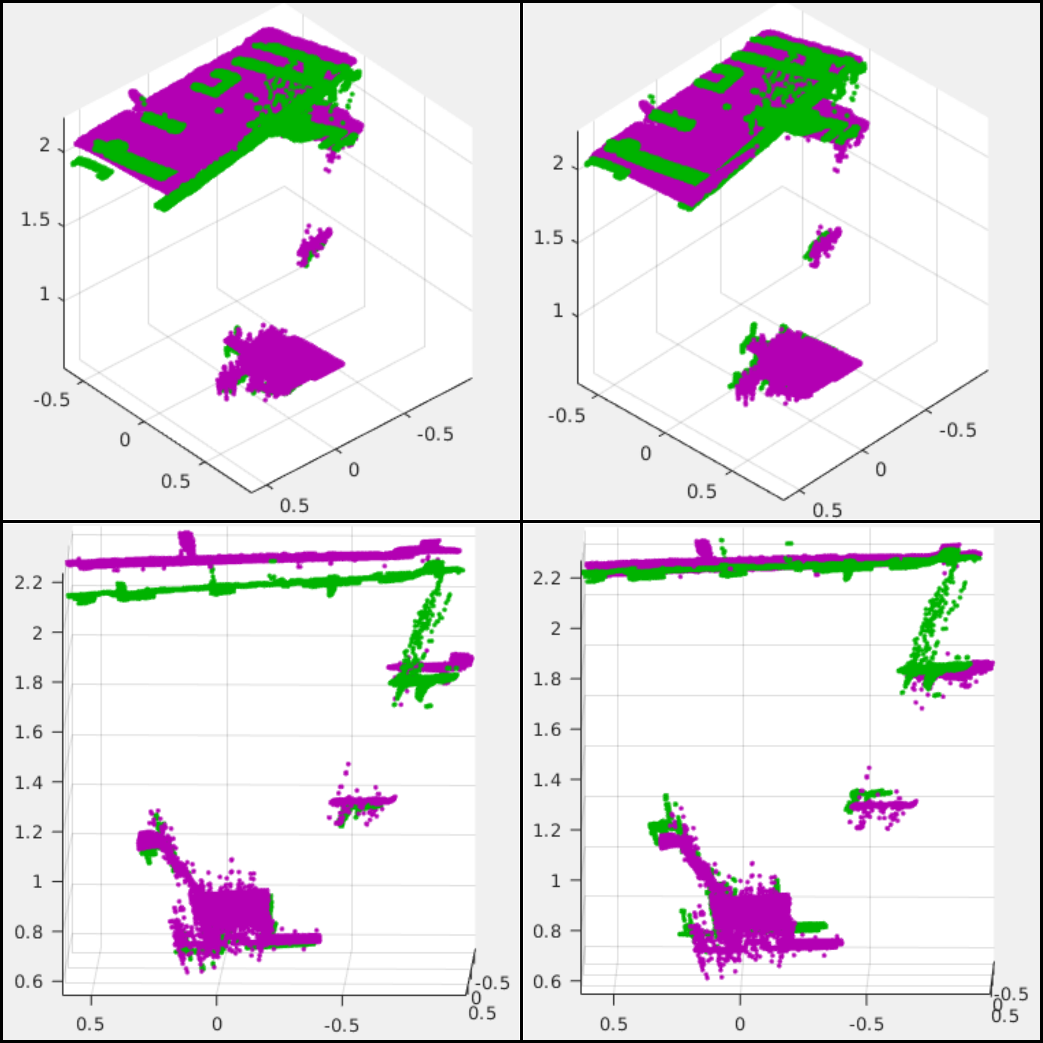
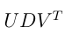
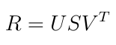
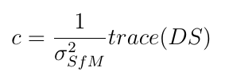
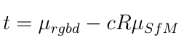
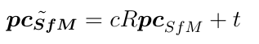
Point cloud registration
LSD-SLAM has inevitable errors because of noise.
The errors in scale and transformation needs to fixed
A SIM(3) least square ICP is applied to fix this error.
WIth SVD of covariance between points clouds as

Slide 22
Software Details
RGBD depth and intensity image were collected as a ROS bag @ 30 fps for ~ 30 seconds.
Intensity images were fed into C++ LSD-SLAM base implementation, which estimates depths from keyframes and relative pose between every tracked frame and keyframe.
Relative pose and keyframe depths are stored in a ROS bag.
Pose and depth estimates are fed into Matlab implementation of Depth Fusion algorithm.

Slide 23
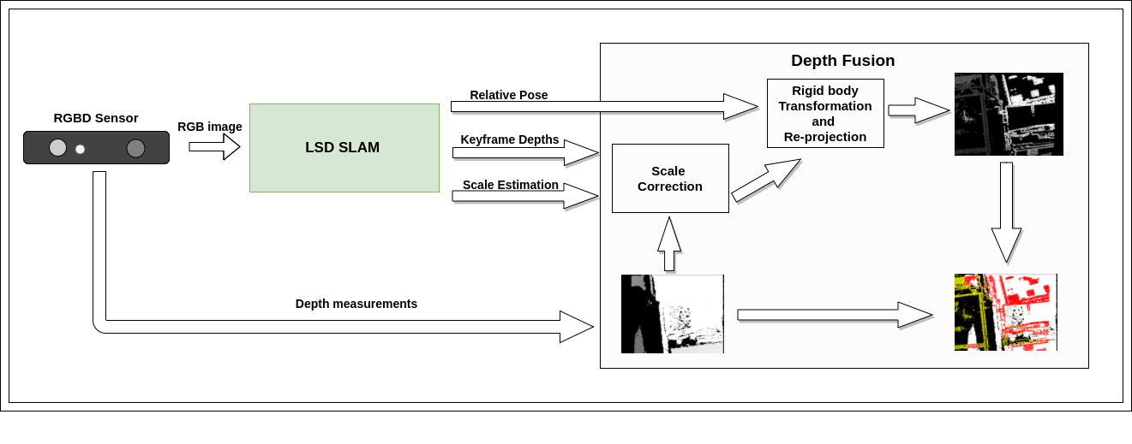
Depth Fusion pipeline

Slide 24
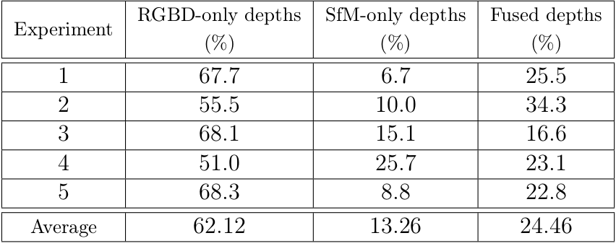
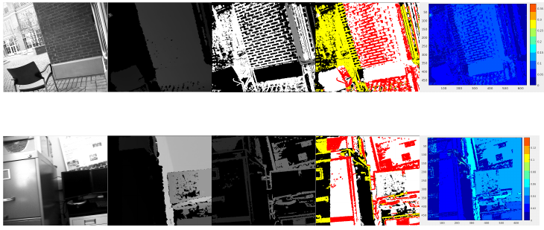
Results Continued
Intensity | Sensor depth | LSD SLAM depth | Fused depth | Standard deviation

Slide 25
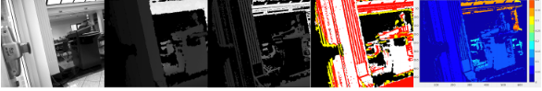


Results
Intensity | Sensor depth | LSD SLAM depth | Fused depth | Standard deviation

Slide 26
Conclusion
The SfM depth estimation complements the RGBD sensor measurements.
The depth fusion algorithm provides the effective way to augment the RGBD depth stream.
Results in improved depth images, with approximately 24% of the fused depths and about 13% of novel depths from the SfM algorithm alone.

Slide 27
Further work
The depth fusion can be generalized to address the non-Gaussian noise distributions.
Back-propagation of RGBD-SfM fused depth imagery into the SfM algorithm can be exploited to improve the camera pose estimation in the camera pose graph.
Preprocessing of RGBD depth measurements to get rid of noisy speckles especially for outdoor measurements.

Slide 28
Thank you

